Slide 1
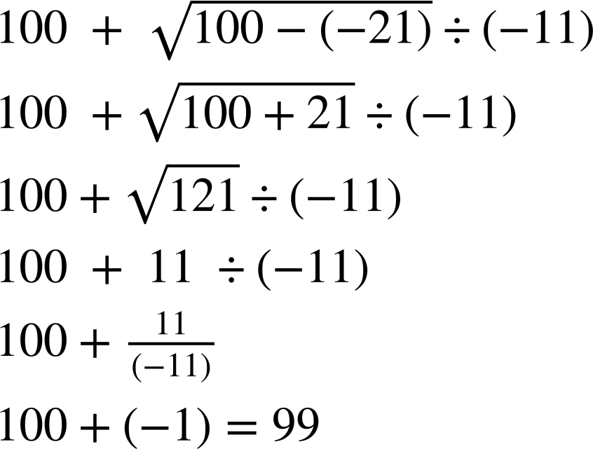
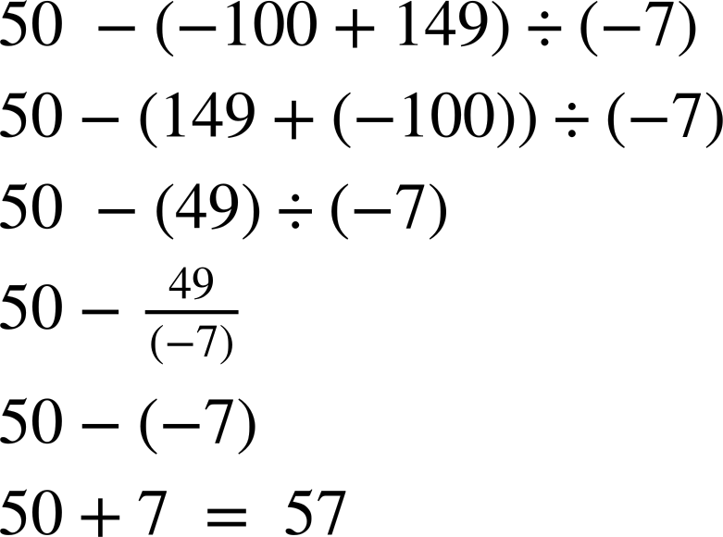
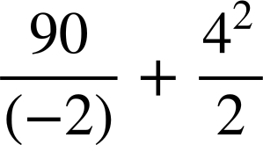
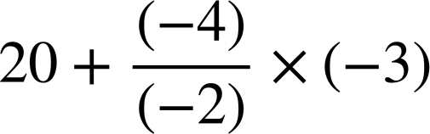
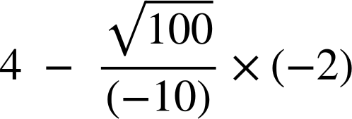
Priority of operations with positive and negative integers and decimals
Task A: Priority of operations with negatives
Fill in the blanks to make the calculation in the centre 24
60 + (-12) × 3
(-240) ÷ (-10)
24
4 + (-2) × (-10)
20 − (-8) ÷ 2
40 + (8) × (-2)
2) Work out the following, ensuring to show your working out.
a)
b)
3) Fill in the pyramid. The number above the block is the sum of the two below.
(-23) + 16 = -7
(-37) + 14 = -23
14 + 2 = 16

Slide 2
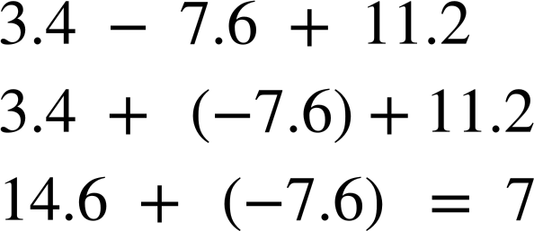
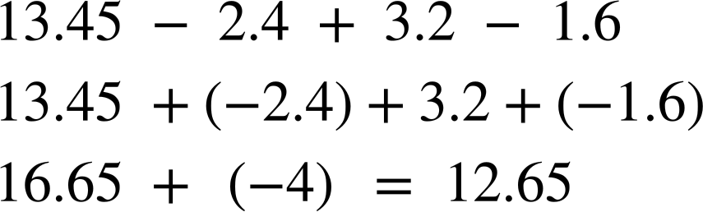
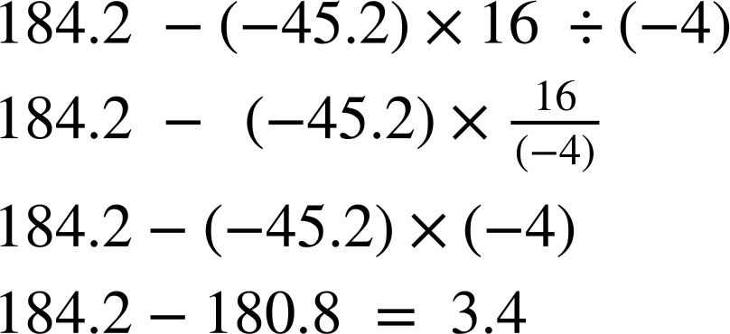
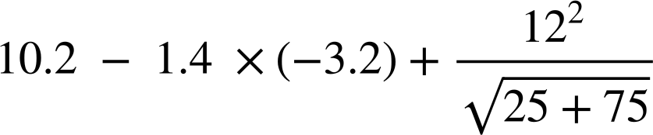
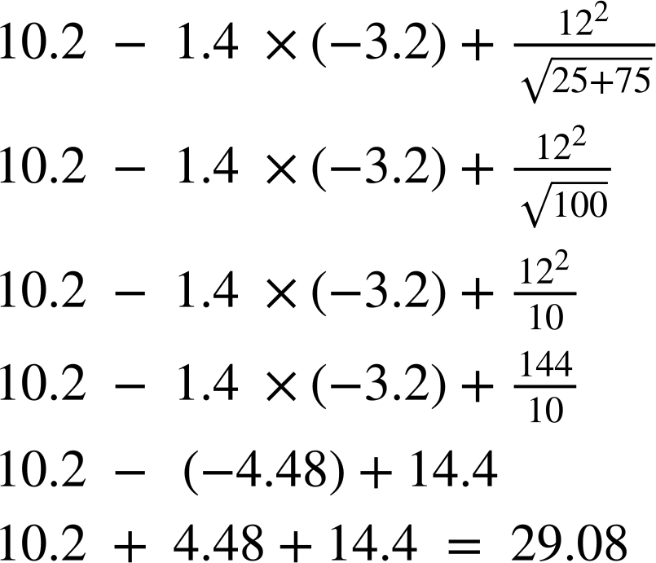
Priority of operations with positive and negative integers and decimals
Task B: Priority of operations with negatives and decimals
1) Work out the following, ensuring to show all your working out.
2) Work out the following, ensuring to show all your working out.
3) Work out the following, ensuring to show all your working out.
4) Work out the following, ensuring to show all your working out.
5) Create your own two questions using a combination of operations and decimals so the correct answer is 24. You must use decimals and ensure to check your calculation with a calculator. There are an infinite number of calculations. These will need to be checked.
Mathematics in Education and Industry
v2.2

